Slide 1

Block coding Developer
Session - 34
Build An Utility App

Slide 2

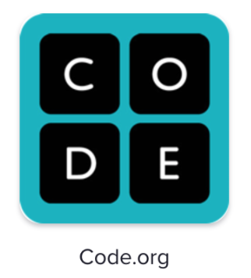
Recall
What we have learn in last session
What challenges you are facing

Slide 3
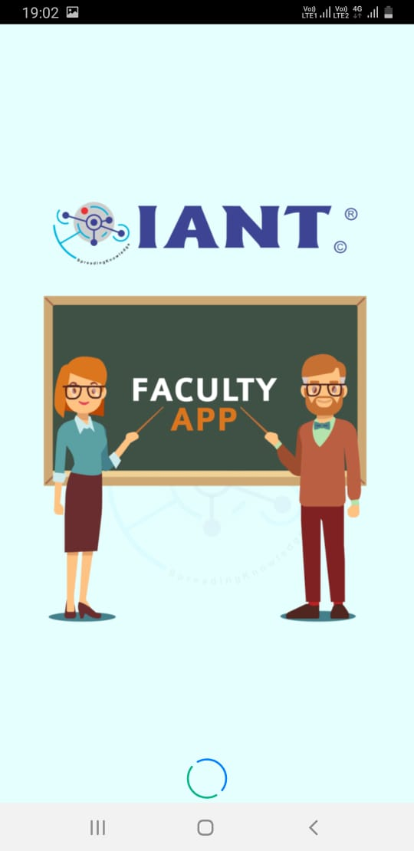
Build Utility App…
We will Learn today:
How to build an utility app
Yoga App

Slide 4
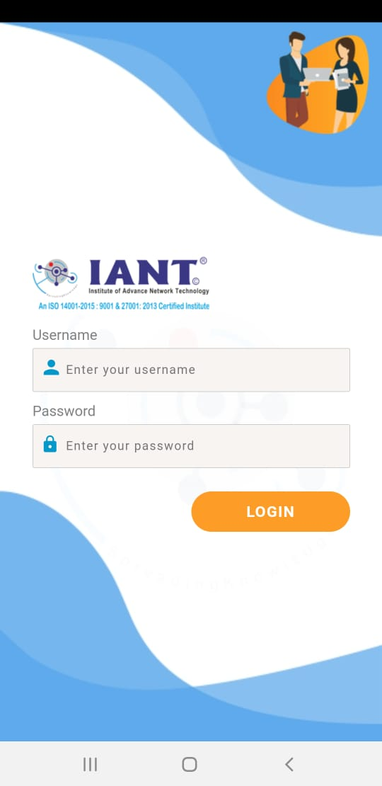
Utility Apps…
Utility Apps are the types of mobile apps that we may use most often without thinking about them as apps
Many of them come pre-installed on your device and serve a single function
Some examples of common types of mobile apps in the utility category are: Reminders, Learning, Calculator…

Slide 5
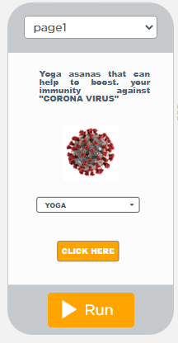
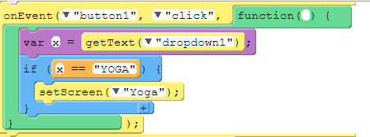

Yoga App – Screen 1

Slide 6
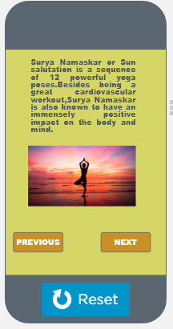
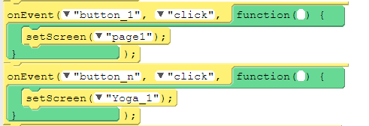
Yoga App – Screen 2

Slide 7
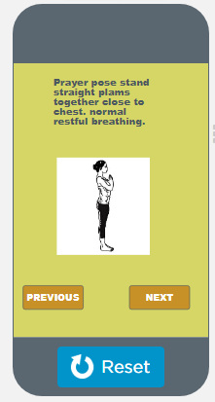
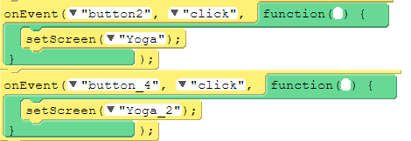
Yoga App – Screen 3

Slide 8
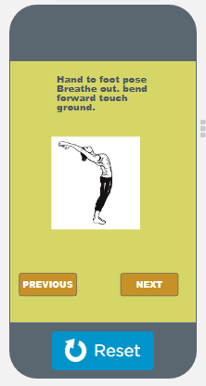
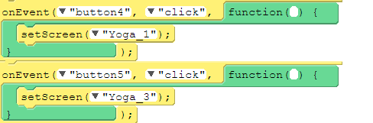
Yoga App – Screen 4

Slide 9
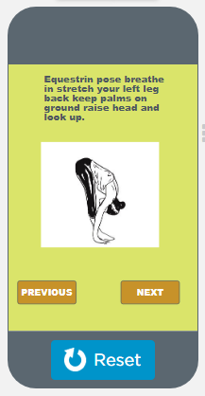
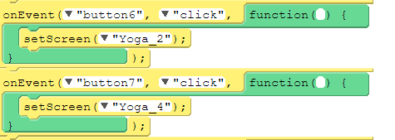
Yoga App – Screen 5

Slide 10
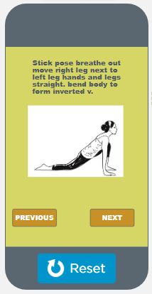
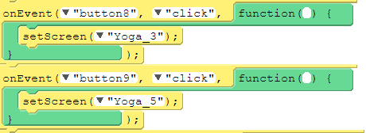
Yoga App – Screen 6

Slide 11
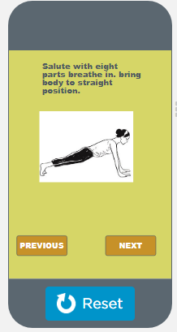
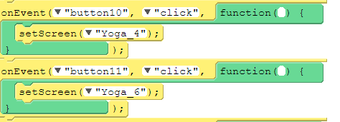
Yoga App – Screen 7

Slide 12
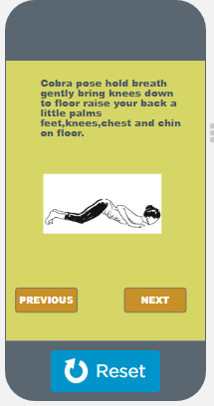
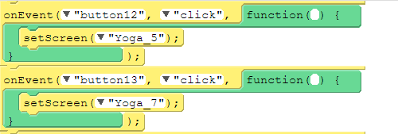
Yoga App – Screen 8

Slide 13
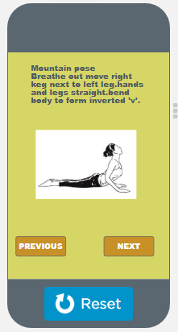
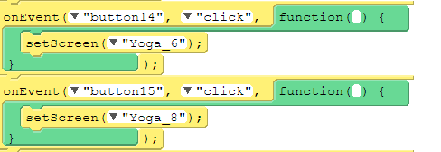
Yoga App – Screen 9

Slide 14
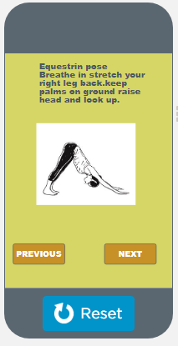
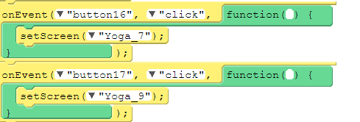
Yoga App – Screen 10

Slide 15
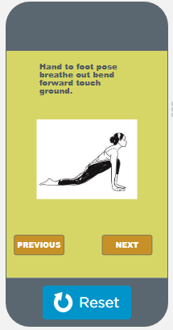
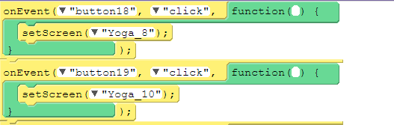
Yoga App – Screen 11

Slide 16
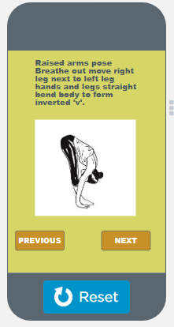
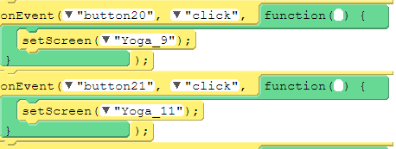
Yoga App – Screen 12

Slide 17
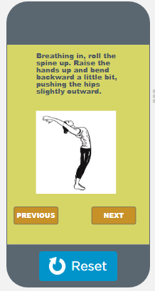
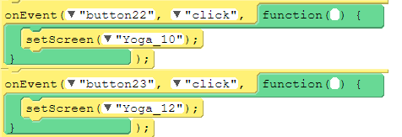
Yoga App – Screen 13

Slide 18
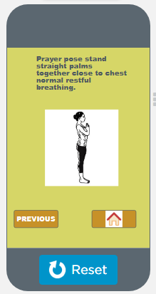
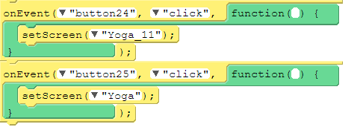
Yoga App – Screen 14

Slide 19
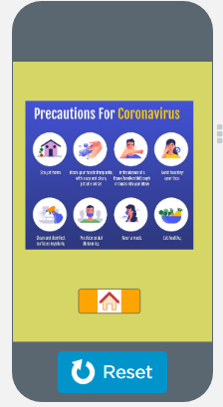
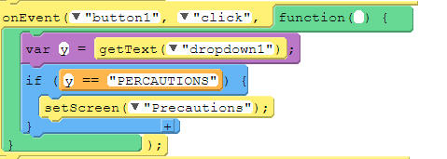
Yoga App – Screen 15

Slide 20

Summary…
Build an utility App

Slide 21

Next Session…
Introduction to HTML
Structure of HTML
What is Heading
What is Paragraph
What is Tag

